Slide 1
TEAM-11
Kevin, Aaron, Mason, Herat

Slide 2
Who will benefit from this
Businesses that are not so big and need assistance from the government for running their businesses.
Businesses that are majorly operated by women.
Businesses that are owned by minorities.

Slide 3
Problem we are solving
Maximizing funding support for minority businesses.

Slide 4
How?
Identifying the features that play an impact on YOU receiving the MAXIMUM funding and ….
Helping you identify the way in which you could double-down on these features.

Slide 5
So, first let’s explore…..

Slide 6
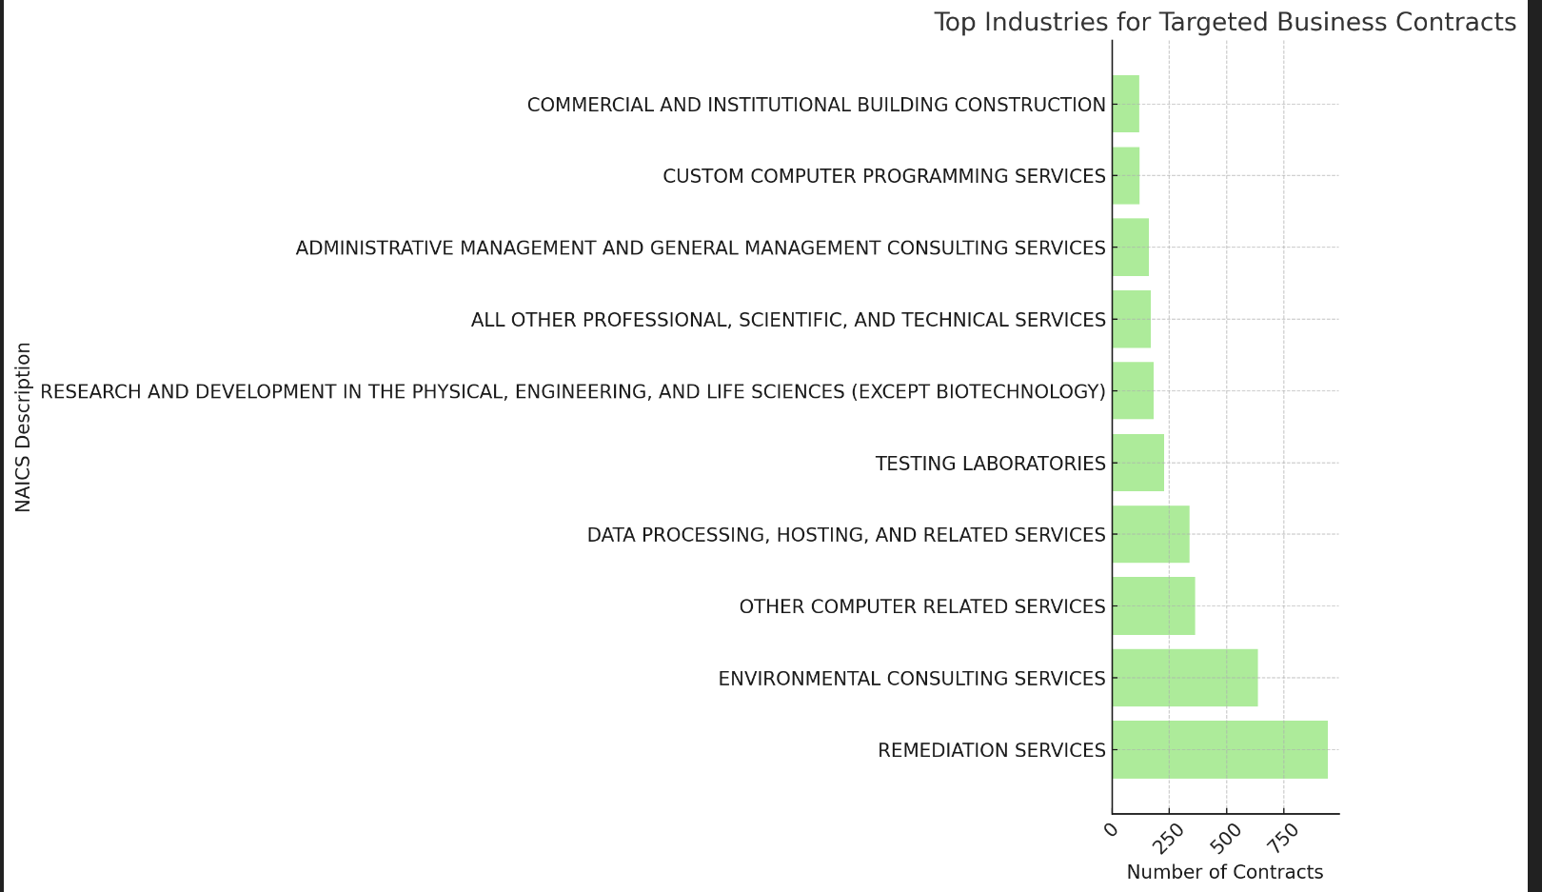

Slide 7
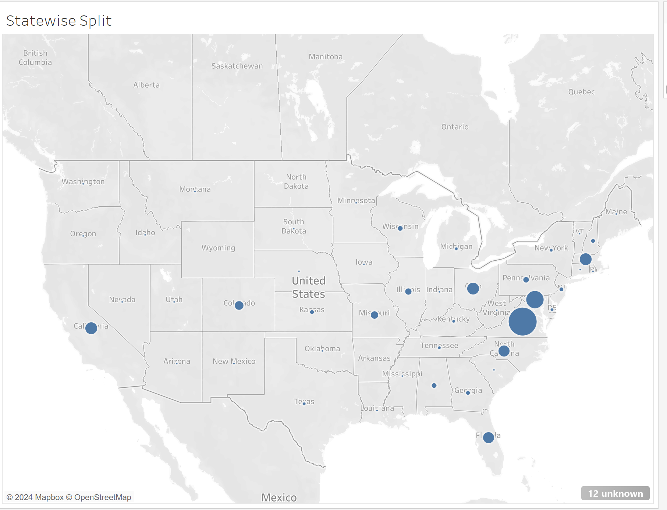

Slide 8
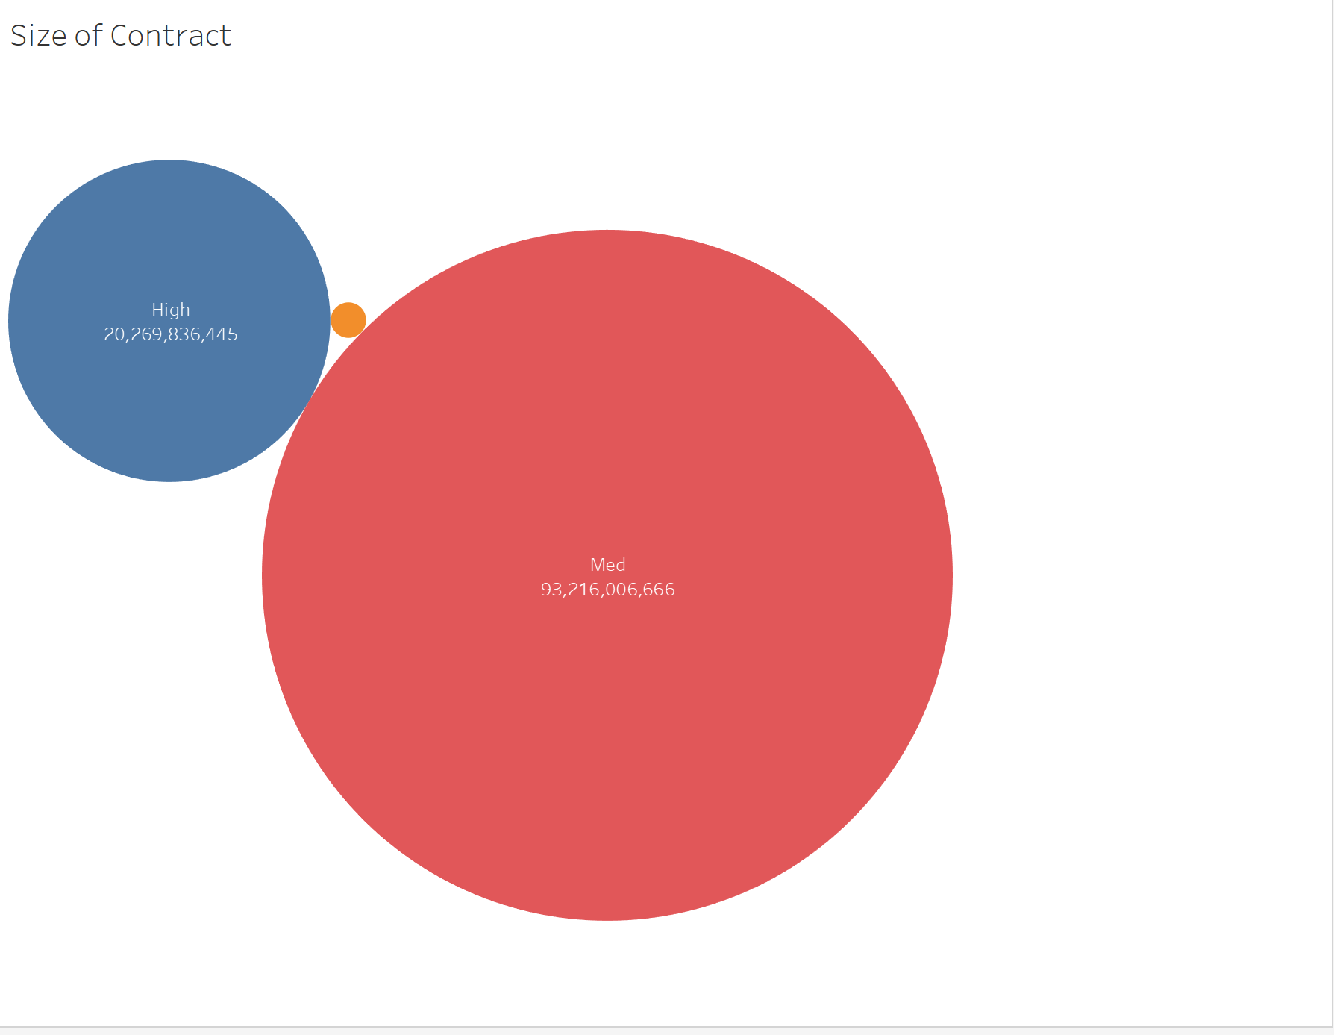

Slide 9
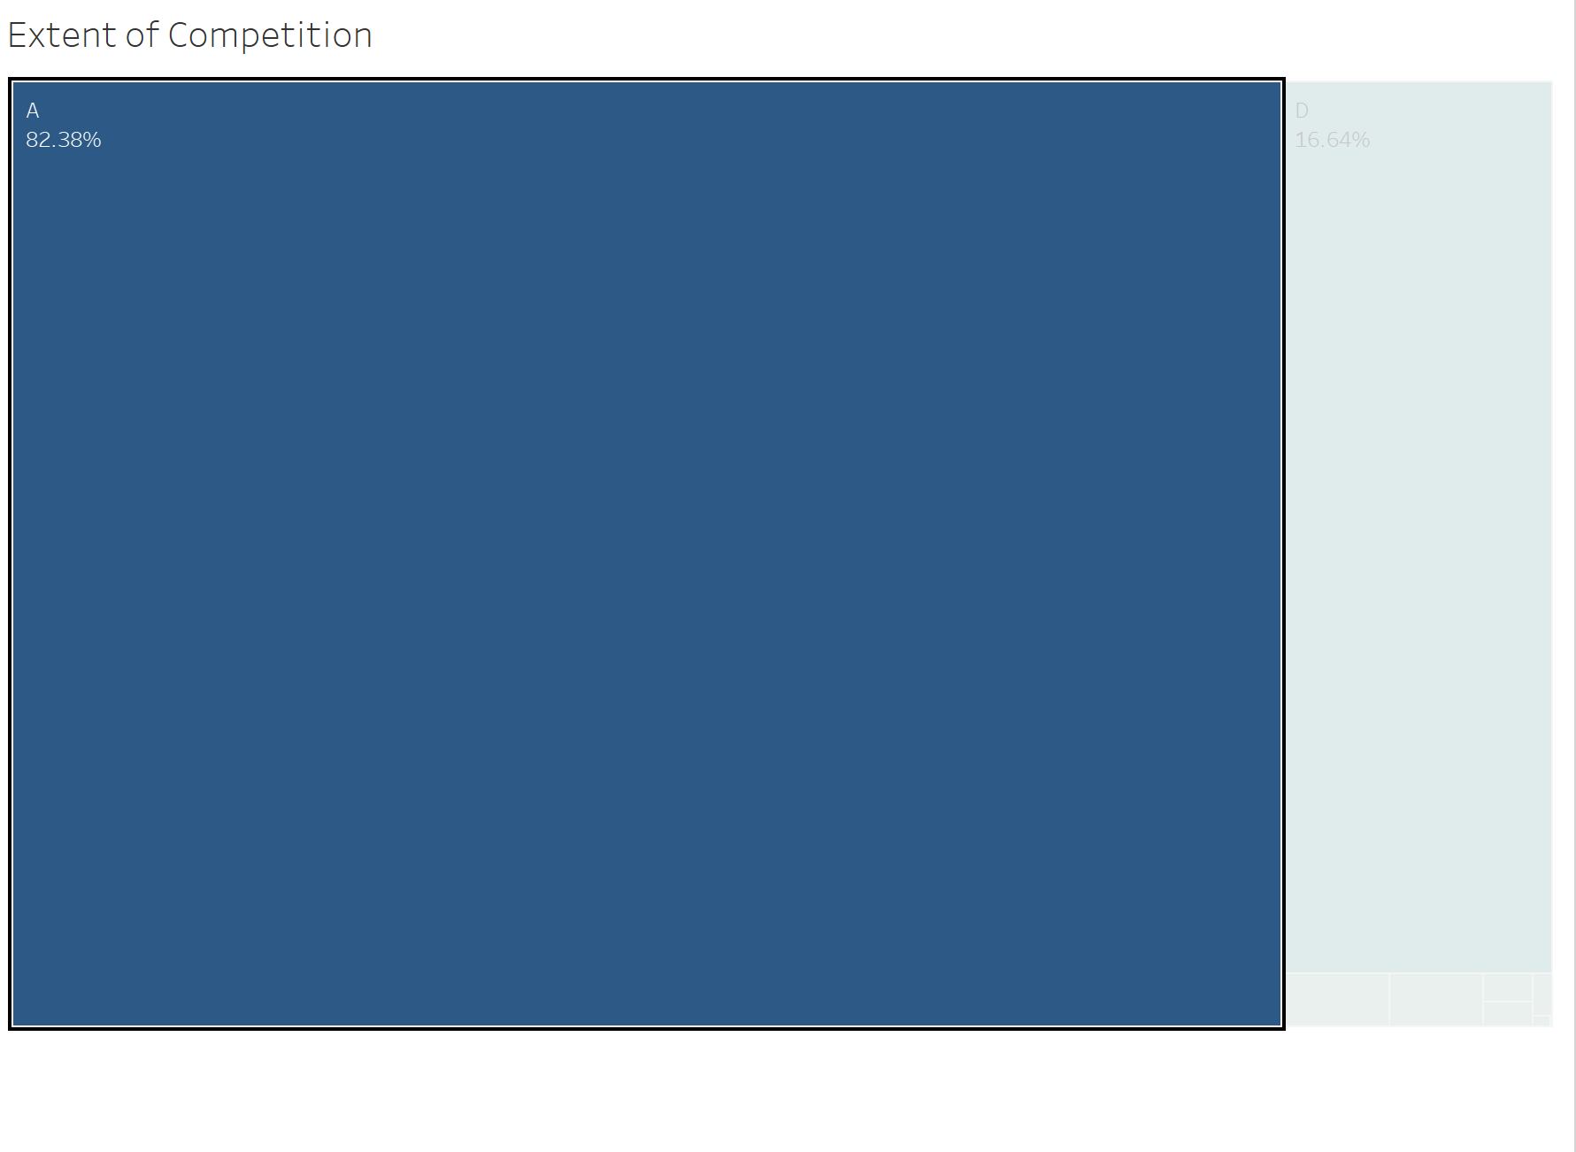

Slide 10
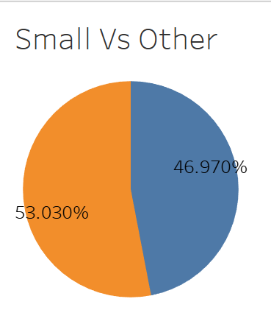

Slide 11
Our Key Features
# the contract was modified
Recipient’s state
Level of competition
Type of industry
Award type
Woman owned business
Minority owned business
Other minority owned business
Business Size

Slide 12


Model 1 - Regression
Encode Features based on categorical or binary
Run Linear Regression
Run GB Regression
Filter data for only businesses run by our client demographics
Compare results!
All Regression results = Far from ideal r-squared values and incredibly high RSME values
We need to find a different model to use!

Slide 13
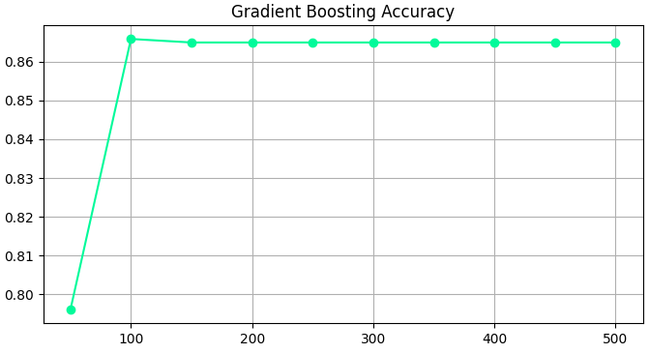


Model 2 - Classification
Binning of potential_value
Encoding values
DecisionTree, RandomForest, AdaBoost, XGB, GradientBoost
GradientBoost wins!
Not only the highest accuracy ALSO highest f1 score!

Slide 14
Insights
Model allows us to predict general funding range
In order to help these businesses thrive, we can run their current bids in the model
If the results are unsatisfactory, then we can compare how their business sizes up to those that are scoring high classifications and see how we can replicate their success
Focus on specific features
Program_activities_funding_this_award
Recipient_state_name
Product_or_service
Award_type = BPA contracts (federal contracts)
Extent_competed = open competitions

